Slide 1


Telecom Subscriber Churn
Chris Kogut

Slide 2
Business Problem – trying to solve
Telecom service provider is experiencing customer churn in their wireless subscriber base
Seek insight into the reasons for this churn

Slide 3
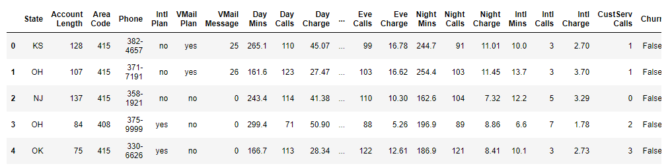
Analytical Problem
Attributes
State | Total Day Min
Account Length | Total Day Calls
Area Code | Total Day Charge
Phone Number | Total Eve Min
Inter Plan | Total Eve Calls
Voicemail Plan | Total Eve Charge
No of Vmail Msgs | Total Night Min
Calls to Cust Svc | Total Night Calls
Churn | Total Night Charge
 | Total Intl Min
 | Total Intl Calls
 | Total Intl Charge
Seek out data to determine reasons for customer churn
Determine if customer churn can be predicted and determine the best level of prediction
  Neural Net
Continuous and categorical variables
Dataset contains 21 columns and 3,333 records

Slide 4
Data Preparation
Basic Statistical Analysis
Performed: Verification that there is no missing data or outliers General mean and correlation analysis across all attributes Feature selection Performed data scaling… from sklearn.preprocessing import MinMaxScaler scaler = MinMaxScaler(feature_range=(0, 1))
 | Churn | Attribute Sets | Numeric To Nominal | Normalize
Neural Net | Yes and No | 15 | Yes * | Yes *

Slide 5
Scenario (Attributes)
After data cleanup dataset contains 15 columns and 3333 records
Scenario , Redundant/Ineffectual
 | Total Day Charge
Account Length | Total Day Calls
Area Code | Total Eve Charge
Inter Plan | Total Eve Calls
Voicemail Plan
No of Vmail Msgs | Total Night Charge
Calls to Cust Svc | Total Night Calls
Churn Indicator
 | Total Intl Charge
 | Total Intl Calls

Slide 6
Data correlation
Churn data is highly imbalanced churn ~500 vs no churn 2,700.
It would make sense to rebalance the dataset.
Finding "Charge" and "Mins" attributes have linear correlation.
Minutes , "Mins"" is considered redundant for each Type and can be removed.
data = data.drop(['State','Day Mins','Eve Mins','Night Mins','Intl Mins'], axis=1)

Slide 7
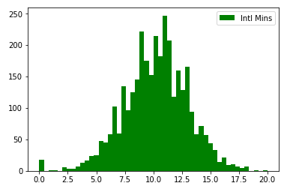
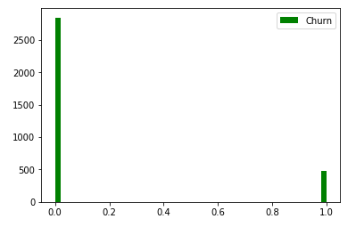
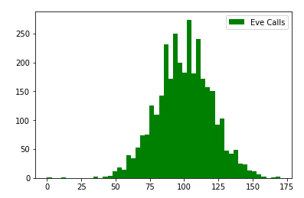
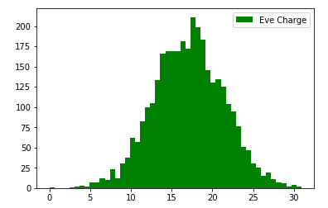
Data Verification/correlation
Sample attributes

Slide 8
Observations – Neural Network model
Model | Training/ Testing | Num of Attributes | Overall Accuracy | TP on Churn | FP on Churn | Tree Size/ Hidden Layer
Neural Net | 80/20 | 15 | 82.59 % | 78.3 % | 9.5 % | 1-3 hidden layer(s)
Neural Net exhibited the very good predictive accuracy
Using Keras framework
  model.add(Dense(20,input_dim=15,activation='relu’))
  model.add(Dense(4,activation='relu’))
  …
  model.add(Dense(2,kernel_initializer = 'uniform',activation='sigmoid’))
  Adam optimizer

Slide 9
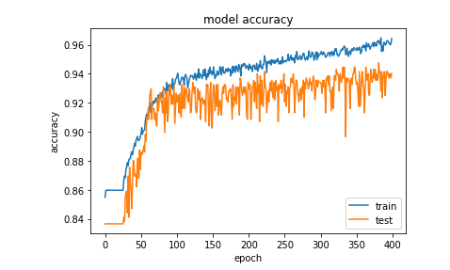
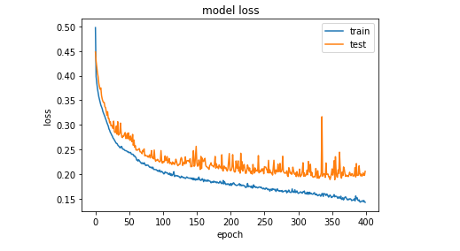
Results: Accuracy, Loss

Slide 10
Decision Tree Analysis - Findings
Cust Svc Call
<=3
> 3
Day Mins
475 of 550
<= 223
> 223
28%
Intl Plan
Voice Mail
No
Yes
Intl Calls
Eve Mins
<=2
>2
>201
Intl Mins
520 of 568
127 of 127
7.6%
>13
31%
117 of 117
7%

Slide 11
Thank you

